Slide 1

WINDOWS
TUTORIAL
Emily Moody
JROTC CyberPatriot

Slide 2

Starting the Virtual Machine
Increase the RAM on the VM-- make sure it’s an exact amount, otherwise it will crash!
Increase the amount of hard drive spac as well.
COmputer Management -> Storage -> Disk Management -> Right click on the memory that is un-allocated -> allocate it

Slide 3
Gather the information
Read the Readme
Check out the forensics questions– you need to make sure that you don’t accidentally delete something essential to solving the problems
Write down important details
Keep a log of what you do– that way if you lose points for something, you can work backwards and resolve the problem

Slide 4

Useful Tools
❏ Process explorer
❏ Avast
❏ Malwarebytes
❏ Information Gathering Scripts
❏ Templates
❏ Decryption Tool-Unlocker
❏ CCleanel
❏ Belarc
❏ Last Activity View
❏ Windows Prefetch Viewer

Slide 5
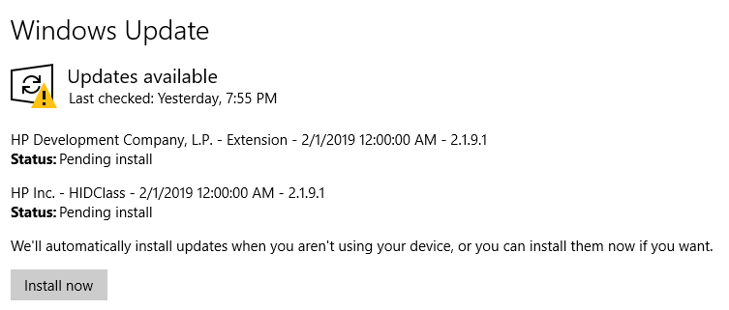
Updates
Set to automatic updates
Make sure the machine is up-to-date
Ensure at this time that the software specified in the Readme is at the right version
It is important to get this done first because it’s time consuming and not something to procrastinate on
Other:
Download service packs and patches not included in the update

Slide 6
Information Gathering on the VM
Open Last Activity View to quickly scan through the recent activity searching for malicious activity
  Use common sense here for the most part-- if something seems uncommon, search!
Open Windows Prefetch Viewer, quickly scan through the prefetch files searching for malicious activity.
  Look for obvious signs of malware
  Ex: Multiple file creations occurring from the same .exe
VIewing Startup Programs/Running Task: cmd -> type “msinfo32” -> Go to the Software Environment tab
Check the following tabs for information:
  Startup Programs
  Running Tasks
  Network Connections

Slide 7
User Account Controls
Local Security Policy is an efficient way to secure lockout times, auditing, and user accounts.
Check for unauthorized accounts– DISABLE, DO NOT DELETE
As a general rule, keep User Account Control on the highest setting
Disable Guest account and make sure users are required to keep secure passwords
Lockout settings:
Enforce Password History: 5 passwords remembered
Maximum Password Age: 30 to 90 days
Minimum Password Age: 5 days
Minimum Password Length: 8 characters
Password must meet complexity requirements?: Yes
Store passwords using reversible encryption?: No.

Slide 8
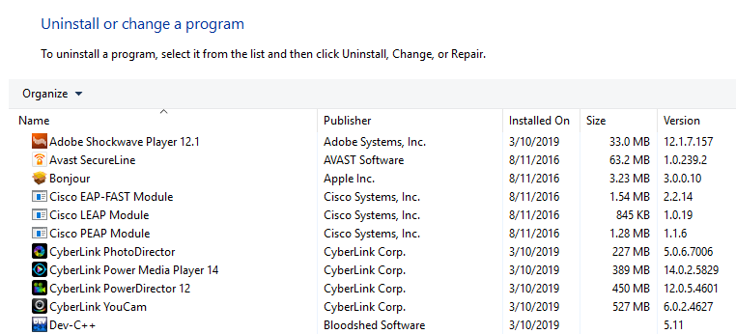
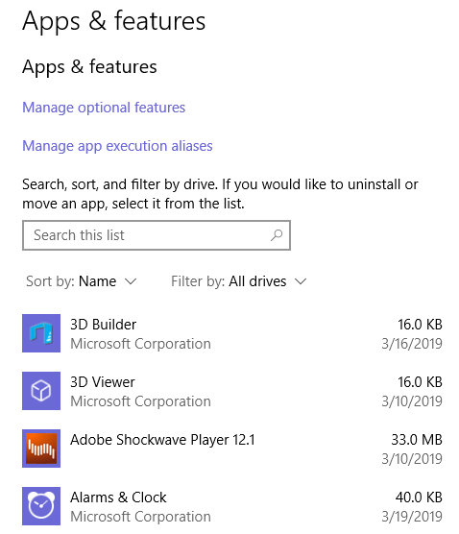
Unnecessary Programs
Anything not required for the PC should be uninstalled– be very careful not to delete something you shouldn’t or something you might need later
Control Panel \ All Control Panel Items \ Programs and Features
Settings \ Apps \ Apps and Features

Slide 9
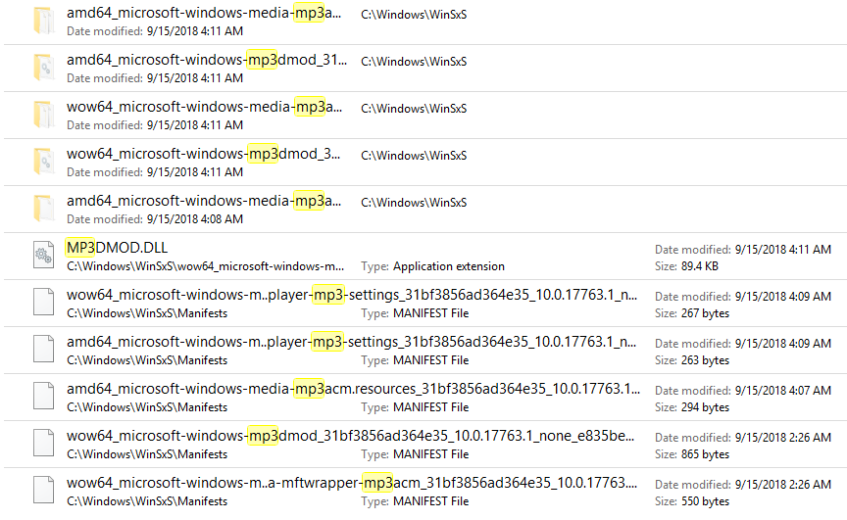

Unnecessary Files
Using File Explorer, find your broadest file scheme and search for .mp3, .mp4, .wav, and any other file types you suspect to be on the PC; this is pretty tedious tbh
You can also adjust the settings from here to make all hidden files viewable, to show file extensions, and to stop the hiding of protected file systems (Under the View panel)

Slide 10
Security Option Policies
(gpedit.msc → Local Policies → Security Options)
Domain Member
  Digitally Encrypt or sign secure channel data: Enabled
  Maximum machine account password age: 30
Interactive Logon
  Display user information when the session is locked: Disabled
  Do not display last username: Enabled
  Do not require CTRL + ALT + DEL: Disabled
  Number of previous logons to cache in case domain controller is not available: 0
Network Access
  Do not allow anonymous enumeration of SAM accounts: Enabled
  Do not allow

Slide 11
Security Option Policies (continued)
Recovery Console
  Allow automatic administrative logon: Disabled
  Allow floppy copy and access to all drives and folders: Disabled
Audit
  Force audit policy subcategory settings (Windows Vista or Later) to
  override audit policy category settings: Enabled
  Shut down system immediately, if unable to log security audits

Slide 12
Security Option Policies (continued)
User Account Control
  Only elevate executables that are signed and validated: Disabled
  Detect application installations and prompt for elevation: Enabled
  Admin approval mode for the built-in Administrator account: Enabled
  Allow UIAccess applications to prompt for elevation without using the
  secure desktop: Disabled
  Switch to the secure desktop when prompting for elevation: Enabled
  Behavior of the elevation prompt for standard users: Automatically Deny Elevation Request
  Virtualize file and registry write failures to per-user locations: Enabled
  Only elevate UIAccess applications that are installed in secure locations: Enabled
  Run all administrators in Admin Approval mode: Enabled
  Behavior of the elevation prompt for administrators in Admin Approval Mode: Prompt for Credentials

Slide 13
Security Option Policies (last one)
Devices
  Prevent users from installing printer drivers: Enabled
Network Security
  LDAP client signing requirements: Negotiate Signing
  Minimum Session Security for NTML SSP Based Clients: Require NTMLv2, Require 128 bit encryption

Slide 14
Enable Windows Firewall
Windows Firewall: Block all inbound connections
Windows Firewall: Private: Allow unicast response - No
Windows Firewall: Private: Display a notification - Yes
Windows Firewall: Public: Apply local connection security rules - No
Windows Firewall: Public: Allow unicast response - No
Windows Firewall: Domain: Allow Unicast Response - No
Windows Firewall: Domain: Display a notification - Yes

Slide 15
Event Log Service
Administrative templates -> Windows Components -> Event Log Service
Maximum application log size: 50,000 KB
Maximum Security Log Size: 100,000 KB
Maximum system log size: 50,000 KB
Prevent local guests group from accessing application log: Enabled
Prevent local guests group from accessing securityt log: Enabled
Prevent local guests group from access system log: Enabled
Retention method for application log: Overwrite events as needed
Retention method for security log: Overwrite events older as needed
Retention method for system log: Overwrite events older than 14 days

Slide 16
Personal-
ization/
Autoplay
User Configuration -> Administrative Templates -> Control Panel -> Personalization
Enable Screen Saver: Enabled
Screen Saver Timeout: Enabled: 900
Password Protect The Screen Saver: Enabled
Force Specific Screen Saver: Enabled
Turn off Autoplay: Administrative Templates -> Windows Components -> Autoplay Policies

Slide 17
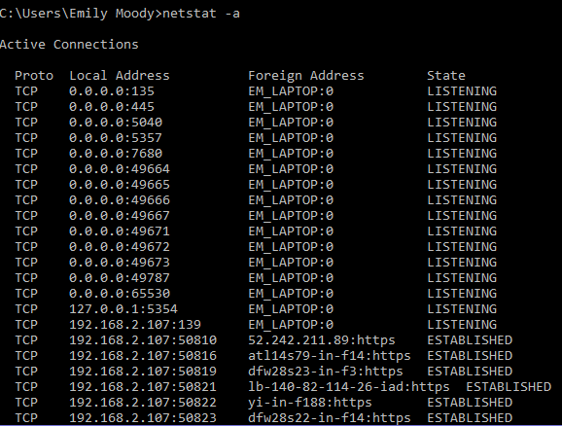
Check Open Ports
CMD: netstat -a
Close ports that don’t need to be open
Open the ports that need to be open (refer to the readme)

Slide 18
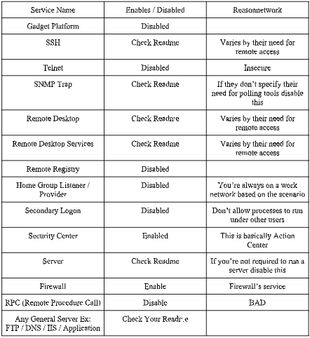
Services

Slide 19
Advanced Auditing
System Auditing
  Other System Events - No Auditing
  Other system Events - No Auditing
Object Access Auditing
  Set ALL to NO AUDITING
Logon - Logoff
  Special logon - Success
  IPsec Main Mode - No Auditing
  Account Lockout - No Auditing
  Ipsec Extended Mode - No Auditing
  Ipsec Quick Mode - No Auditing
  Logoff - Success
  Network Policy Server - No Auditing
  Logon - Success / failure
DS Access
  ALL to NO AUDITING

Slide 20
Advanced Auditing (continued)
Detailed Tracking
  ALL BUT Process Creation to No Auditing
    Process Creation - Success
Policy change
  Audit Policy Change - Success / Failure
  Authentication Policy Change - Success
Account Management
  Distribution group Management - No Auditing
  Computer Account Management - Success
  User Account Management - Success / Failure
  Security Group Management - Success /failure
  Other Account Management Events - Success / Failure
  Other Account Management Events - Success / Failure
  Application Group Management - No Auditing

Slide 21
Advanced Auditing (continued)
Account Logon
  Credential Validation - Success / Failure
  The rest - no auditing
Priviledge Use
  Sensitive Privilege Use - Success / failure
  The rest - no auditing

Slide 22
Quick Fixes
Download antivirus unless otherwise specified
Open Scheduled Tasks to check for errors, suspicious activity, etc.
Programs and Features: Telnet should normally be switched off unless otherwise specified; search for other applications that shouldn’t be there
Use Process Explorer to search for anything suspicious running on the PC
Disable Remote Desktop (almost anything remote except Remote Procedure Call)
Disable file sharing between accounts
Power Settings: reuire logon upon wakeup
Clear DNS cache: ipconfig/flushdns
Configure default accounts according to the readme

Slide 23
Happy Hardening!
Emily Moody
JROTC CyberPatriot

